Slide 1

Group 3
Example class 1
Members:
Mira (U2122140E)
Woon Yee (U2120622C)
Ng Tze Kean (U2121193J)

Slide 2
Background
Worse case of insertion sort is O(n^2)
Worse case of merge sort not-inplace is O(n * log(n))
Worse case of merge sort inplace is O(n^2 * log(n))

Slide 3
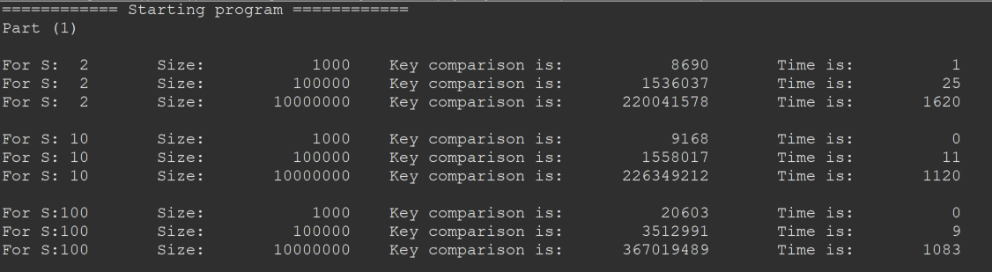
Part (1)

Slide 4
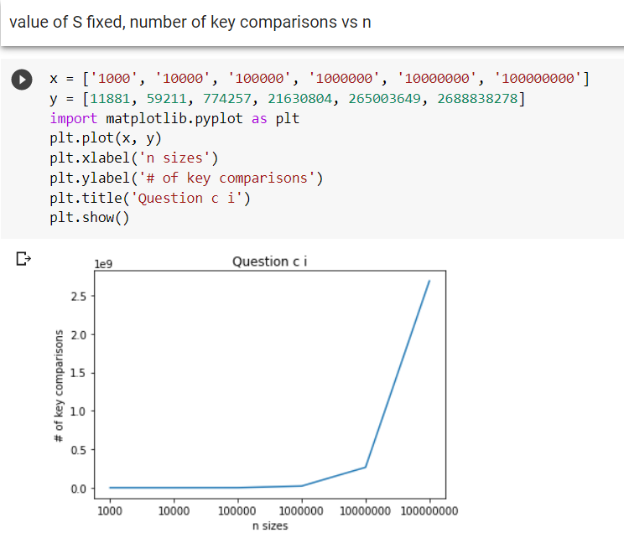
Part (1) - C Language - Not in Place

Slide 5
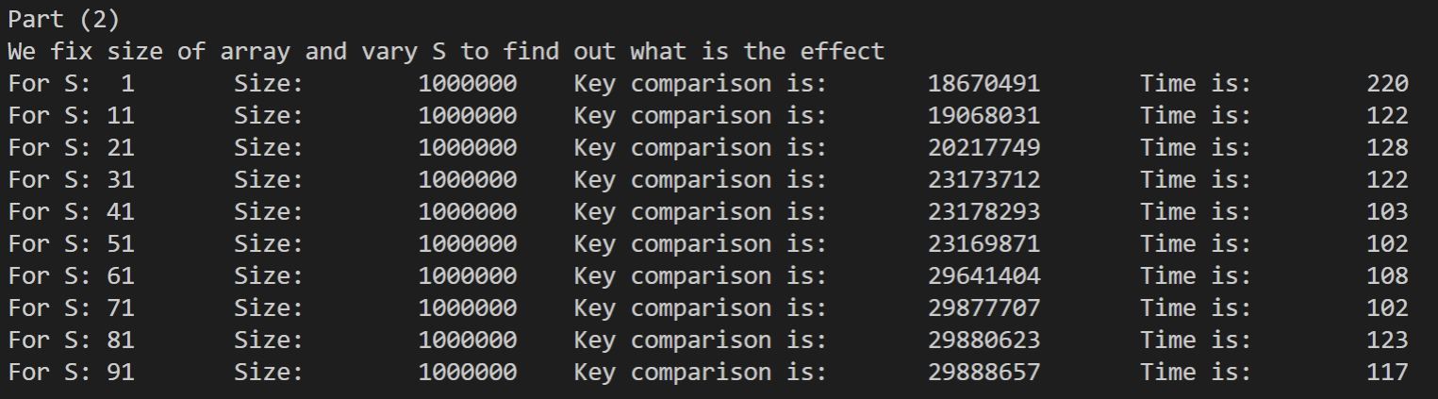
Part (2)

Slide 6
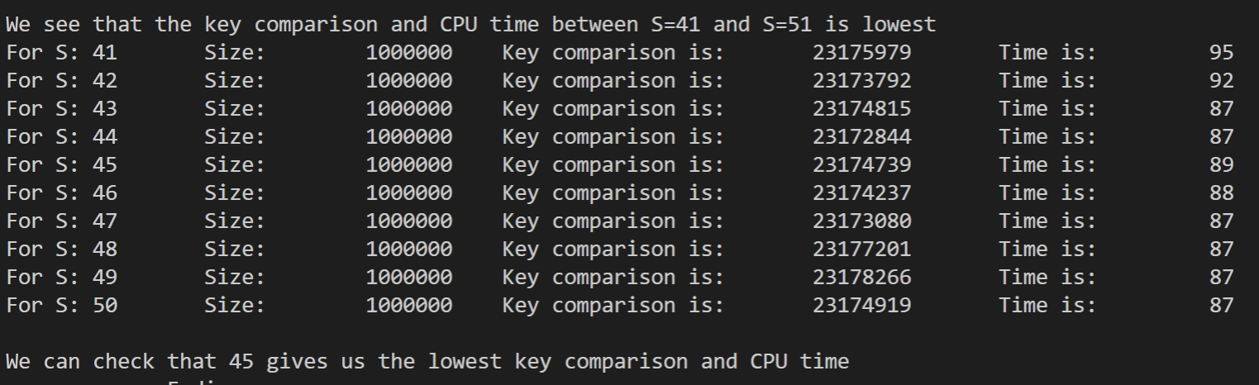

Slide 7
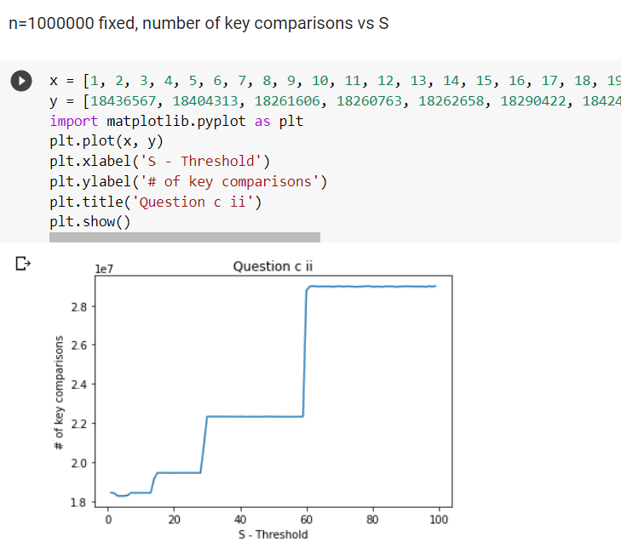
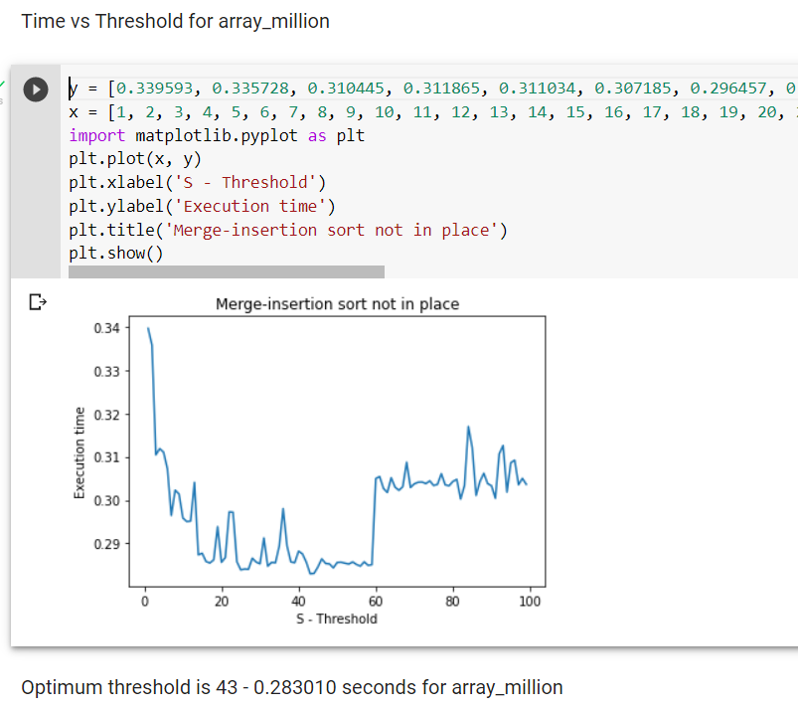
Part (2) - C Language - Not in Place

Slide 8

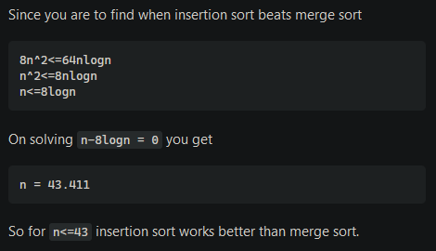
Notes:
https://stackoverflow.com/questions/26397284/for-inputs-of-size-n-for-which-values-of-n-does-insertion-sort-beat-merge-sort

Slide 9
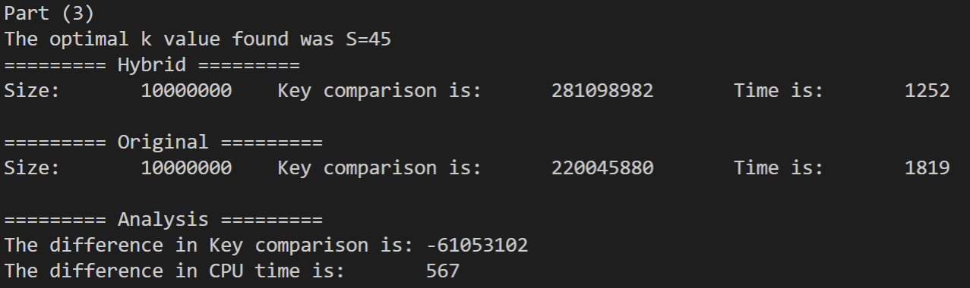
Part (3)
Notes:
Interesting observation: Hybrid is faster than original even though there is more key comparisons

Slide 10
Part (3) Analysis
Merge sort is a recursive algorithm, each time mergesort() is called, local variables must be stored on stack and each time the function returns, variables must be loaded from the stack
There is context store and load overhead
Insertion sort does not suffer from the overhead 🡪 at size S=45, overhead is higher than insertion sort worst case scenario
Notes:
Interesting observation: Hybrid is faster than original even though there is more key comparisons

Slide 11
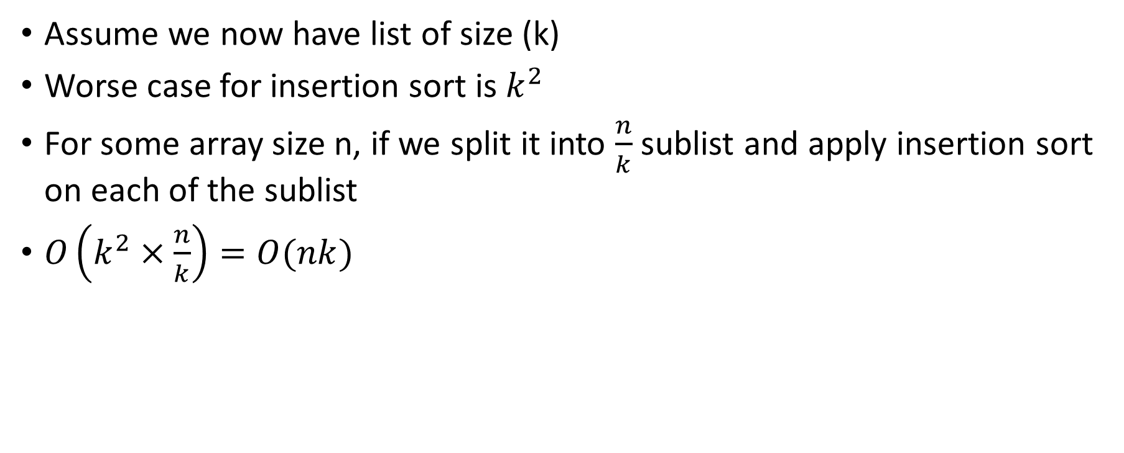
Part (3) Analysis (Time complexity)
Notes:
https://www.geeksforgeeks.org/sorting-by-combining-insertion-sort-and-merge-sort-algorithms/

Slide 12
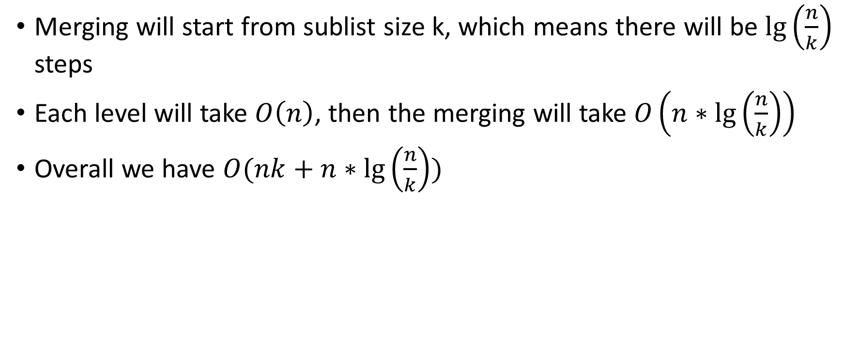
Part (3) Analysis (Time complexity)
lg(n/k) levels/iterations to finish the merge sort
Notes:
https://www.geeksforgeeks.org/sorting-by-combining-insertion-sort-and-merge-sort-algorithms/

Slide 13
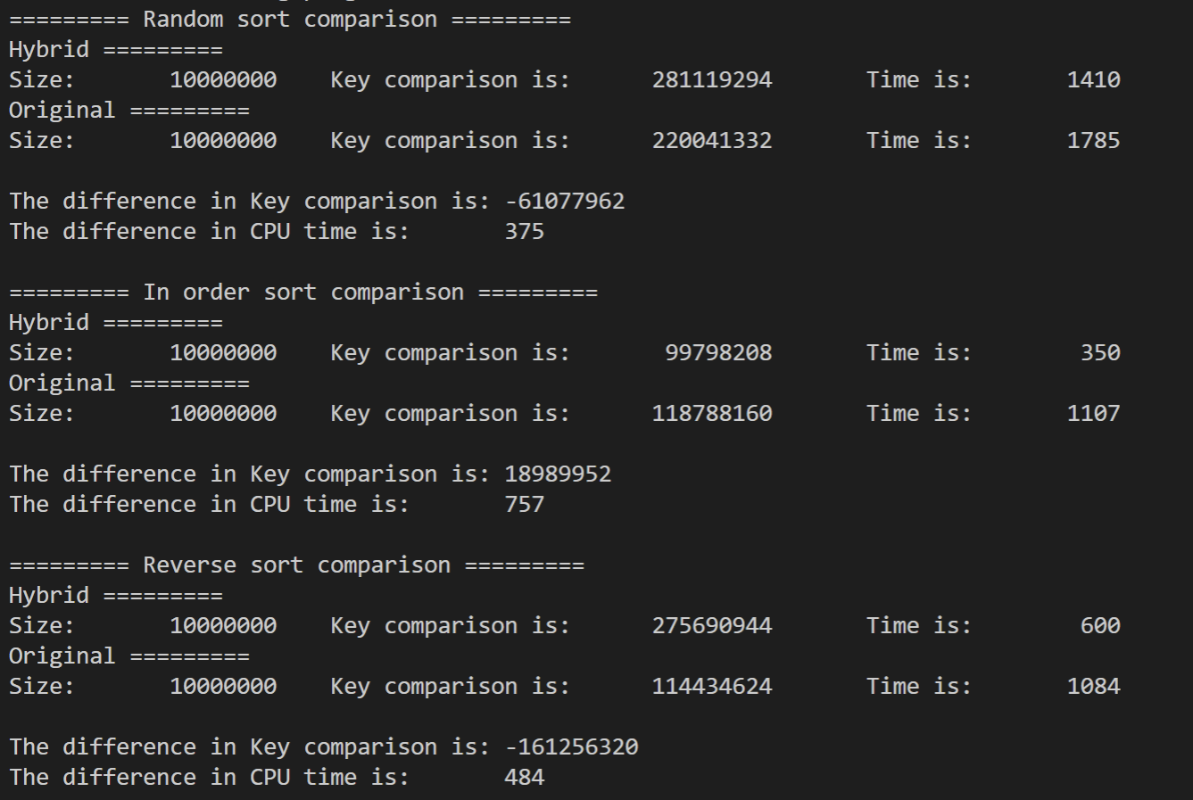

Slide 14
References
All references are appended into speaker notes

